Slide 1
IoT Rush Challenge
Compete for prizes

Slide 2

Task 1: Control an LED from a web app
In this task you will assemble and test a simple system which allows a user to control a light from a web-based application. The application is called ‘MyHome’.
The code for this application is written in Python but you don’t need to have prior knowledge of Python to do the task.
The task has 2 stages:
Build the light circuit and run a simple Python script to test it
Compete the web application script and run the app
Read all the instructions carefully!

Slide 3
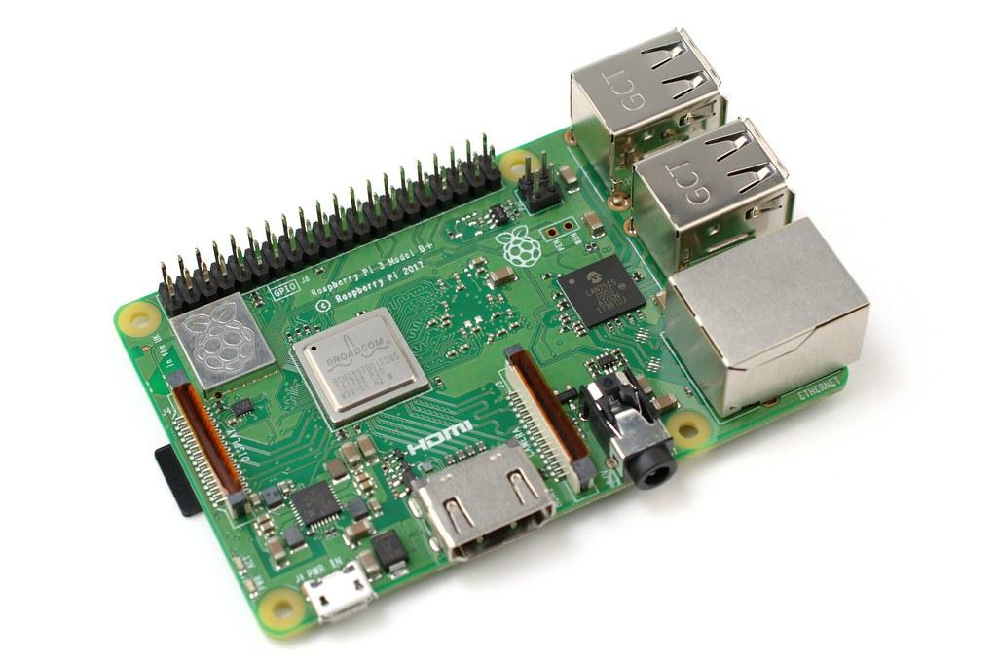
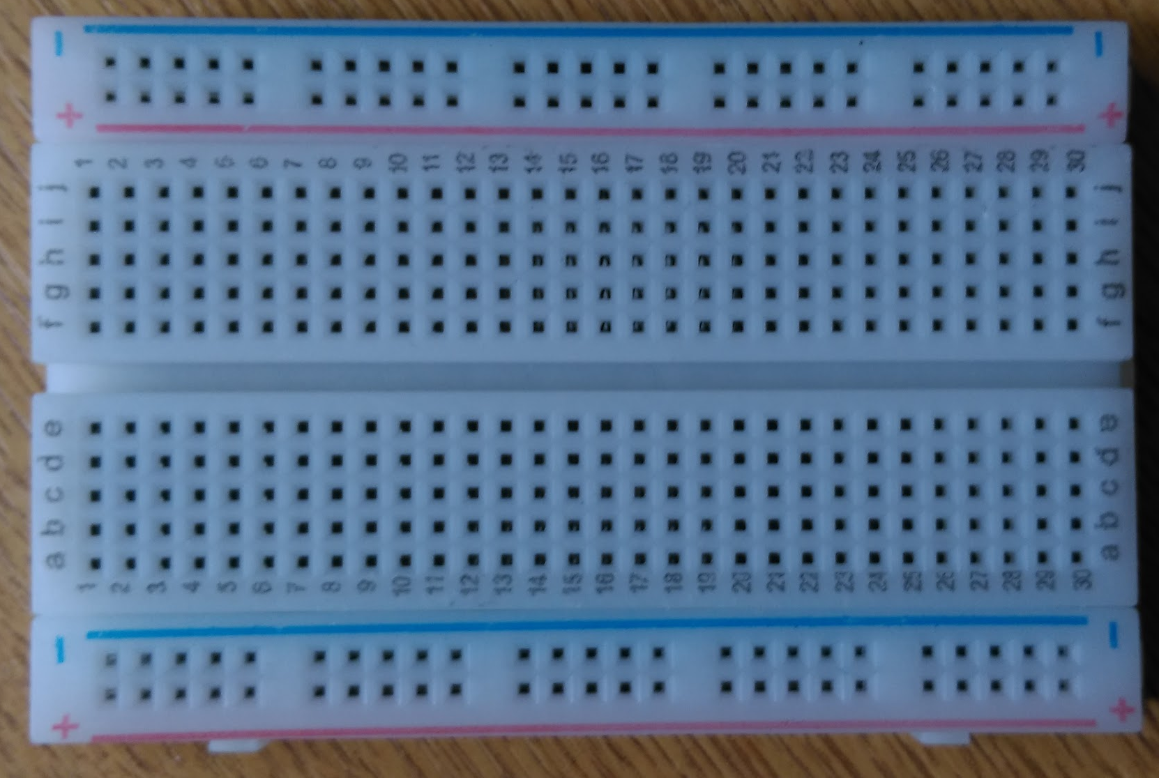
Check you have the following items before starting:
Raspberry Pi | A very small computer running a Linux-based operating system. Yours should be up and running already. There should be a folder on the desktop called 'Subject_Focus_Day’. This has the files you’ll need today inside it.
Breadboard | The breadboard is a way of connecting components together in a circuit without having to solder them.

Slide 4
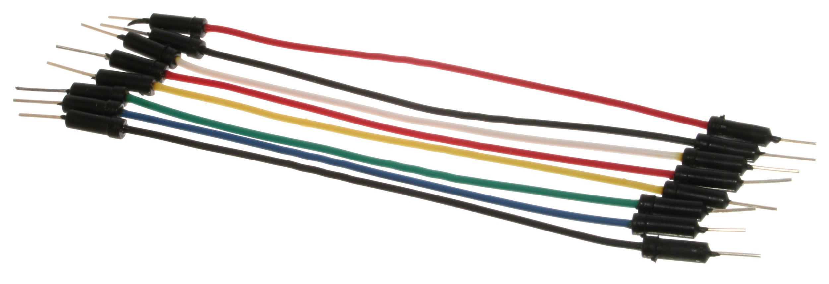
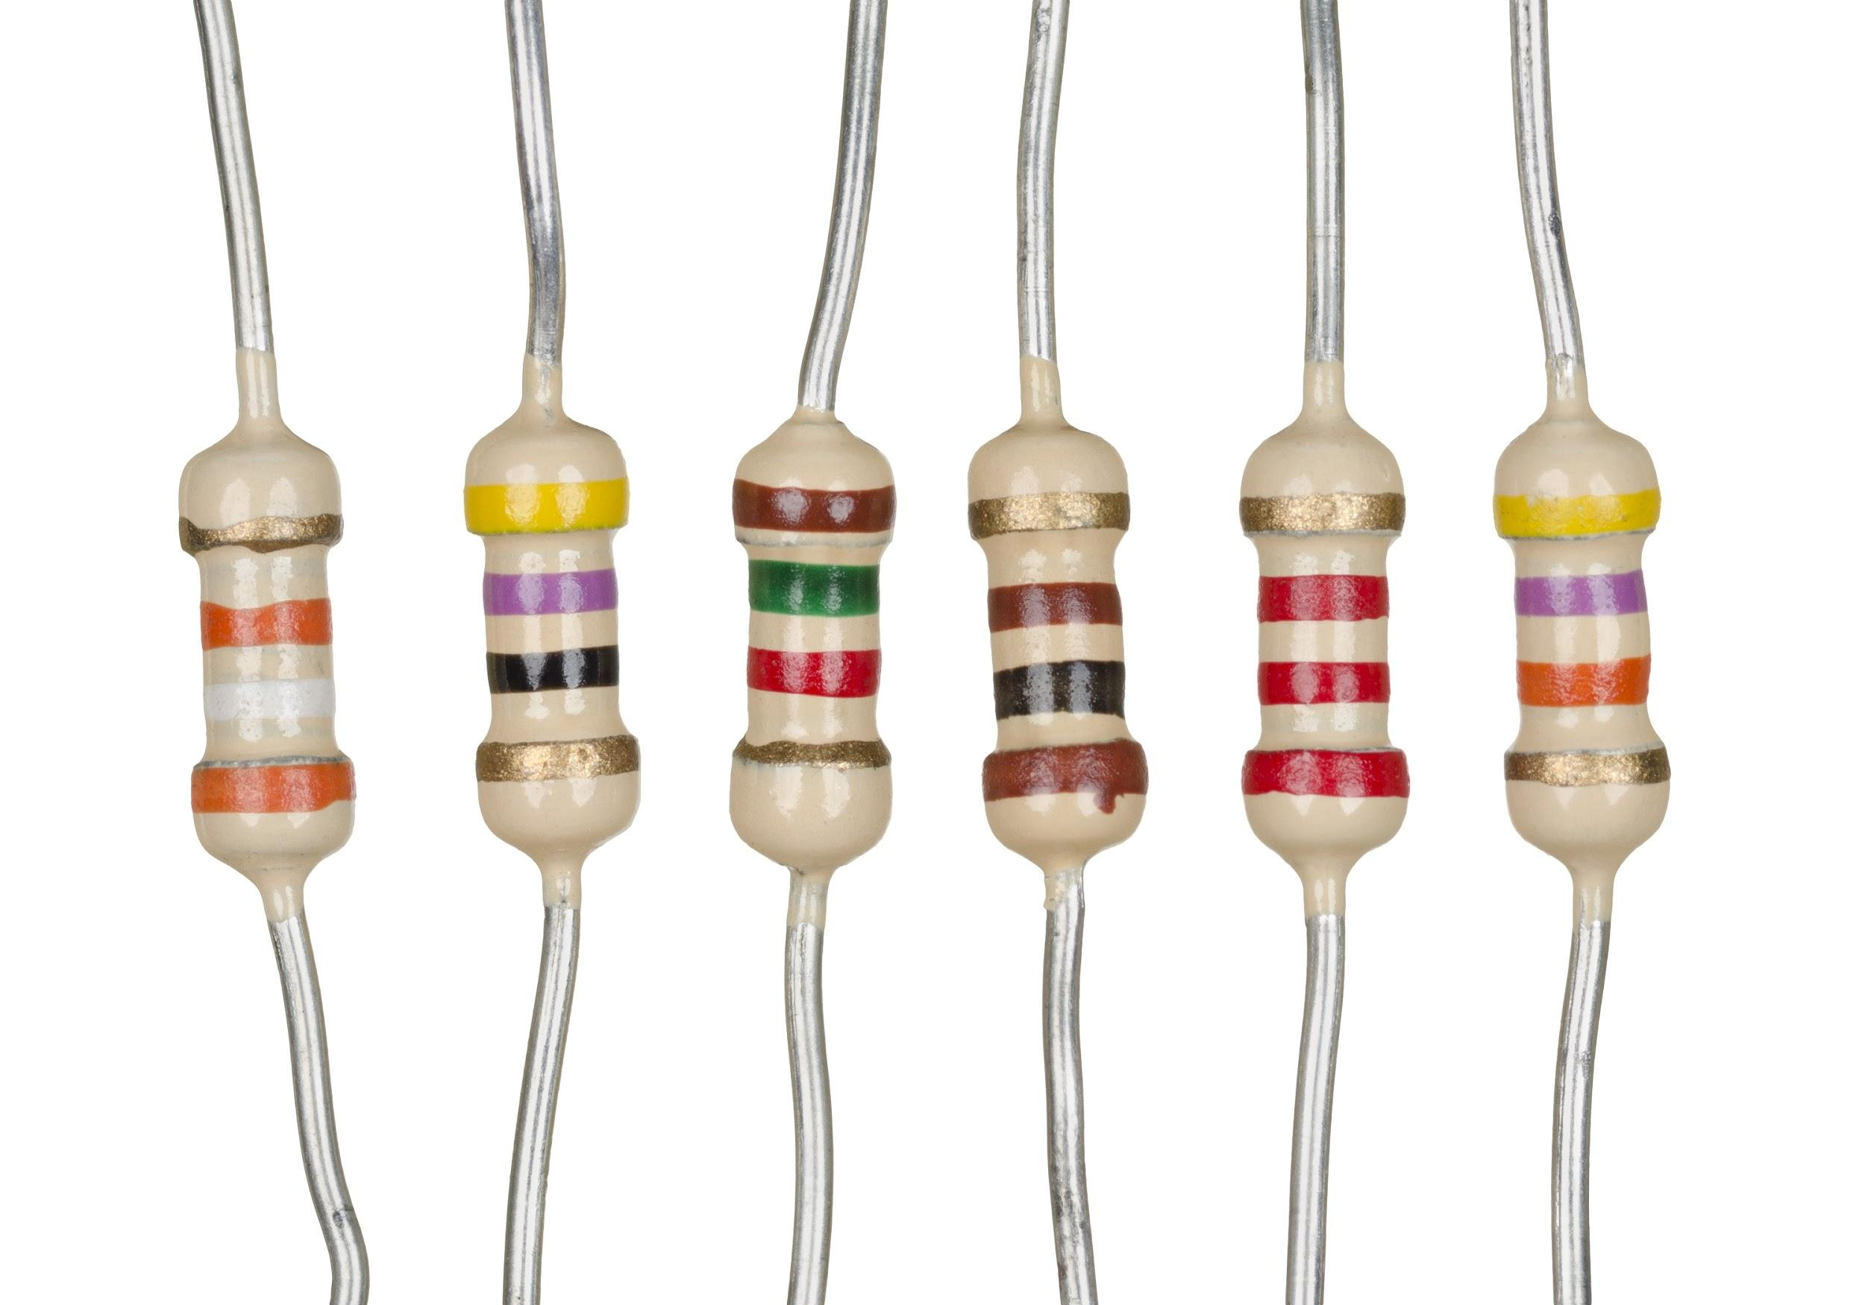
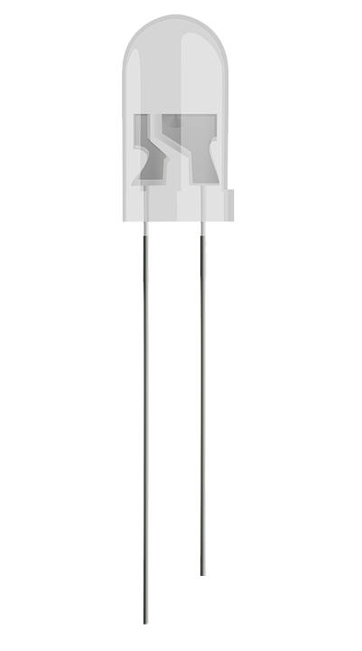
Check you have the following items before starting:
Jumper cables | These are used to 'jump’ from one part of the breadboard to another. You’ll need to use the ends with the ’pins’ on to connect to the breadboard, and the ends with the holes in will connect to the GPIO pins on the Raspberry Pi.
Resistor | This component controls the amount of current flowing through a circuit. The colours specify the amount of resistance provided by the resistor, which is an amount measured in Ohms.
LED | A Light Emitting Diode (LED) glows when electricity passes through it. The longer leg (known as the ‘anode’), is always connected to the positive supply of the circuit. The shorter leg (known as the ‘cathode’) is connected to the negative side of the power supply, known as ‘ground’.

Slide 5
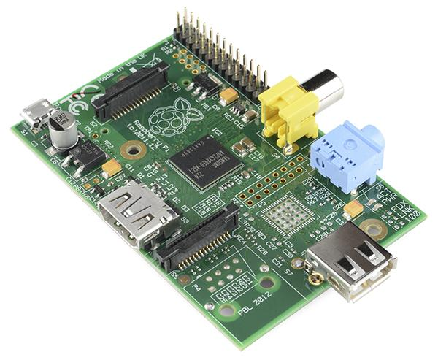
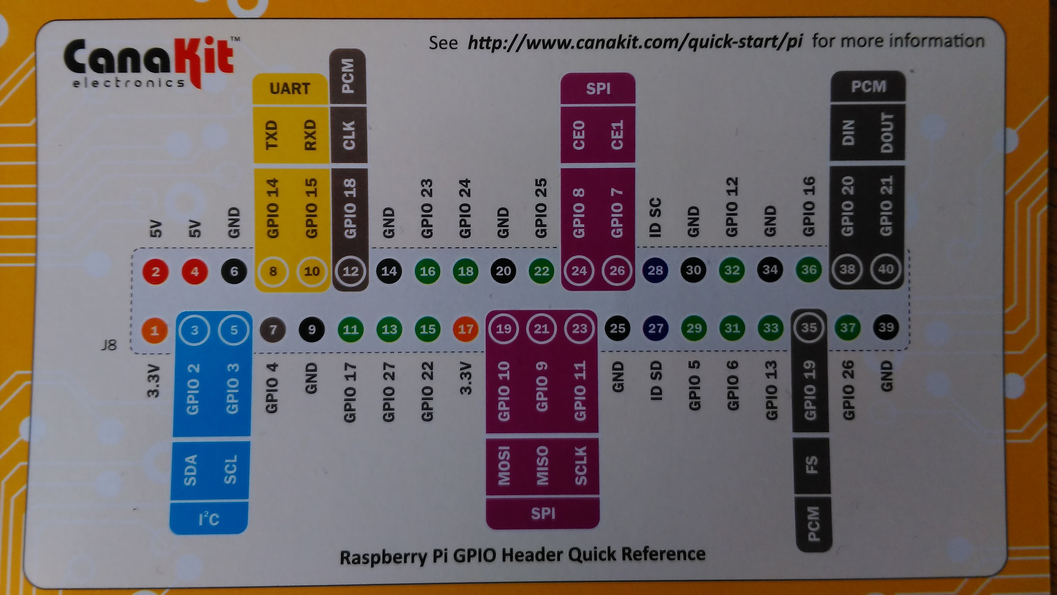
GPIO Pins
Pin 1
Also worth knowing before you start…
General Purpose Input Output (GPIO) pins provide a way for the Raspberry Pi to interface with the outside world by connecting to external electric circuits. The picture on the right shows the arrangement of the GPIO pins on the model of Raspberry Pi you are using. Pins marked GND are Ground pins.

Slide 6
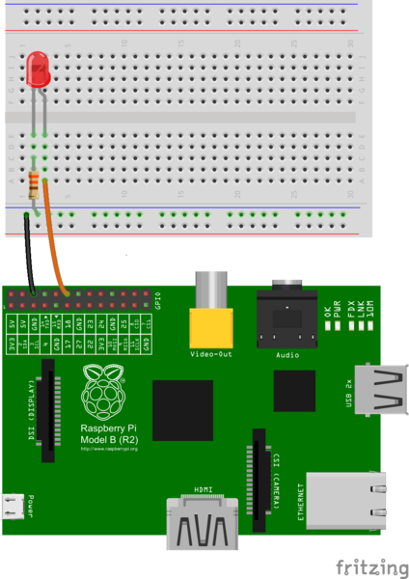
Part A: Build the light circuit
You should turn your Raspberry Pi off for the next bit, just in case you accidentally short something out. You shouldn’t need to remove it from its case, but you can if you want to.
Use one of the jumper wires to connect a ground pin to the rail, marked with blue, on the breadboard. The female end goes on the Raspberry Pi's pin, and the male end goes into a hole on the breadboard.
Then connect the resistor from the same row on the breadboard to a column on the breadboard, as shown above.
Next, push the LED legs into the breadboard, with the long leg (with the kink) on the right.
Lastly, complete the circuit by connecting pin 18 to the right hand leg of the LED. This is shown here with the orange wire.
Source: https://thepihut.com/blogs/raspberry-pi-tutorials/27968772-turning-on-an-led-with-your-raspberry-pis-gpio-pins

Slide 7
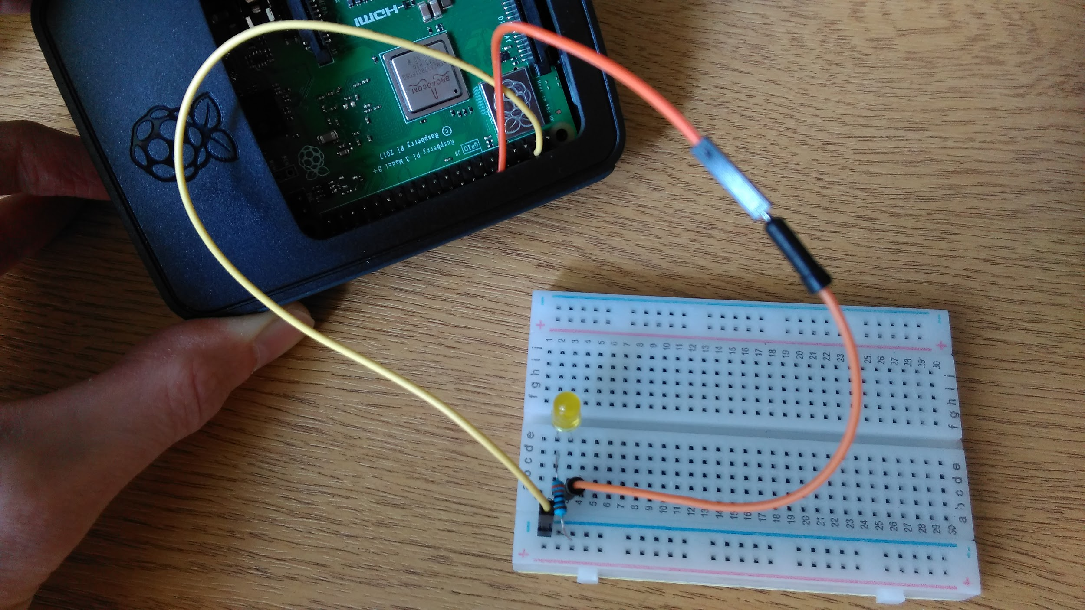
Pin 1 from this angle!
Pin 5 or any other ground pin
Pin 18
Other end of resistor to same row as short LED leg, Other end of Pin 18 cable to same row as long leg of LED
Anywhere on the negative (blue) line

Slide 9
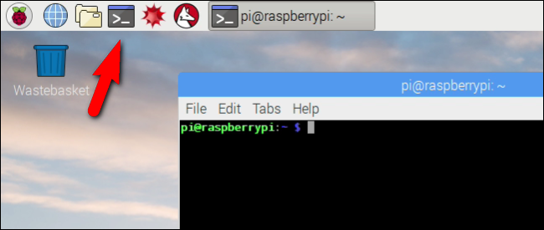
Test the light circuit
Next you’re going to run a simple Python script to test your light circuit. The script has been written for you and is called LED.py.
Click the terminal icon in top toolbar to open a terminal window:

Slide 10
Test the light circuit
Type the following command to go to the location of the LED.py file in the filesystem:
cd ~/Desktop/Subject_Focus_day
The ~ symbol is a ‘tilde’ and it is on the right side of the keyboard above the Shift key
Pressing <Enter> on the keyboard will run the command.
Next run the following command:
python LED.py
This command told the Python interpreter to run the LED.py script.

Slide 11

Test the light circuit
Did your LED light up?
Ask a tutor if you ran into problems.

Slide 12
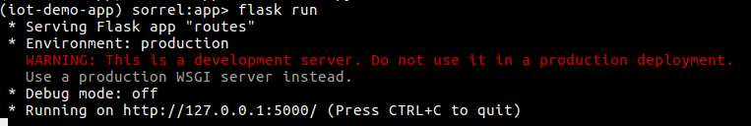
Part B: Control the light from a web app
Next you need to complete the web application so the light can be controlled from a web browser.
Run the web application
From the same terminal, type the following commands:
source bin/activate
cd app
python routes.py
You should now see a message in the terminal like this one:
Ask a question if you want any of this explaining!

Slide 13

Access the app in a browser
<CTRL+Click> on the link and the app should open in a browser.
See anything?
Clicking the button won’t do a thing of course because we haven’t put in the right code yet!

Slide 14
Edit the app code
There are 2 Python files of interest inside the Subject_Focus_Day folder on your desktop: LED.py and app/routes.py.
LED.py is the script we ran to test the light circuit; routes.py is the script for the web app.
Right click the LED.py file and select, ‘Open with > Python 3 (IDLE)’
Identify 2 lines of code which you think are responsible for turning the light on and off. A comprehensive explanation of the code is available via the link on page 6.
Locate routes.py (inside the app folder) and open it in Python 3 (IDLE).
Copy and paste the 2 lines from LED.py to the appropriate lines in routes.py file. Comments (in red) offer some help. Note that the lines you insert must be indented to the same level as the comments. These lines of code will be executed in response to different URLs being requested by the browser. For example, http://127.0.0.1:5000/on will trigger the ‘on’ code, while http://127.0.0.1:5000/off and http://127.0.0.1:5000/ will trigger the ‘off’ code.
Save the file (<CTRL+s>)

Slide 15

Restart the app
Stop and restart the web app from the terminal window:
<CTRL+c>
python routes.py
Refresh the page in the web browser (F5)
Try clicking the button
What happened?
If the light went on/off, you're done with Task 1!

Slide 16
Task 2: Design the perfect user interface
In this task you will improve the design of the existing ‘MyHome’ app interface.
The task involves a little bit of CSS. CSS is short for ‘Cascading Style Sheets’ and it is a markup language used to style web pages.
Don’t worry if you haven’t learnt CSS before – these instructions should help you make some basic changes to the appearance of the ‘MyHome’ interface.

Slide 17

First some basic design principles!
Before you edit the CSS to change the look of the page, here are a few tips for designing user-friendly buttons...
Make your buttons look and behave like buttons
Label the buttons with what they do for users
Avoid relying on colour alone to convey important information
Avoid certain colour combinations (e.g. red and green)
Keep these in mind when considering what edits to make to the CSS.

Slide 18
Edit the CSS
Inside the Subject_Focus_Day folder, locate the ‘style.css’ file (it’s in app > static > css)
Right click the file and do ‘Open with > Text Editor’
Notice that this file contains some blocks of ‘code’.
Each one of these blocks targets some specific element(s) in the page and applies some style rules to it.
For example, this block targets the button identified by the ‘lightOff’ id and makes its text red:
a#lightOff {
color: red;
}
Ask a question if you want any of this explaining!

Slide 19
Edit the CSS
Here are a couple of other style rules you could experiment with:
box-shadow: 2px 2px;
background-color: #DDD;
You can also target an element in a particular `state’, like when a user hovers over it:
a.button:hover {
background-color: #CCC;
}
Ask a question if you want me to explain this.

Slide 20

Edit the CSS
There are more examples of things you can do with CSS here:
https://www.w3schools.com/css/default.asp
And here is a neat tool for identifying colours as hexidecimal codes:
https://www.google.com/search?q=color+picker
Have a play!

Slide 21

Task 3: Plan a pitch
Imagine you are seeking investment to develop a marketable version of the ‘MyHome’ app.
For this final task, plan a 2-minute pitch to an audience of potential investors.
Because 2 minutes is very little time, select some ‘key points’ and communicate them clearly.
Suggested points:
What will your app do?
Who is your app aimed at?
How will they benefit from using it?
What is novel about it?
Ready to pitch?

